Slide 1

Carvana Advertising Insights
Kushal Satyanarayana

Slide 2
Introduction
Thank you for taking the time to go through my presentation! I’m excited to share some findings on the improvement of advertising spends of various channels here at Carvana.
By examining key metrics such as Return on Investment (ROI), Customer Acquisition Cost (CAC), Cost total per click (CPC) and engagement analysis across various channels for Carvana.
Throughout the presentation, I’ll provide with an overview on how I approached the set of problems assigned and share actionable insights to enhance overall strategy. Throughout the assessment, I have used SQL,Python, Excel for Data Analysis.
How Company Name increased sales by XX%

Slide 3
8.Based on what you know about channel performance, what recommendation would you give for re-allocating spend given we are increasing budget by 20% next year?
Assuming that there’s a 20% increase in spend for year 2023. For 2022 the budget was $2,89,500 and for year 2023 it increased to $3,47,400.
Performance of each channel in bringing in sales and customer footprint are two major deciding factors, Return on Investment (ROI), Cost per Conversion (CPC), and Customer Acquisition Cost (CAC) are the major KPIS . Channels that demonstrate higher adjusted score should be prioritized for additional funding, as they are likely to generate the best returns on the increased budget.
I have calculated weighted score for each channel based on these variables as decision making factors. The next slide goes into the details of the adjusted scoring.
Problem statement

Slide 4
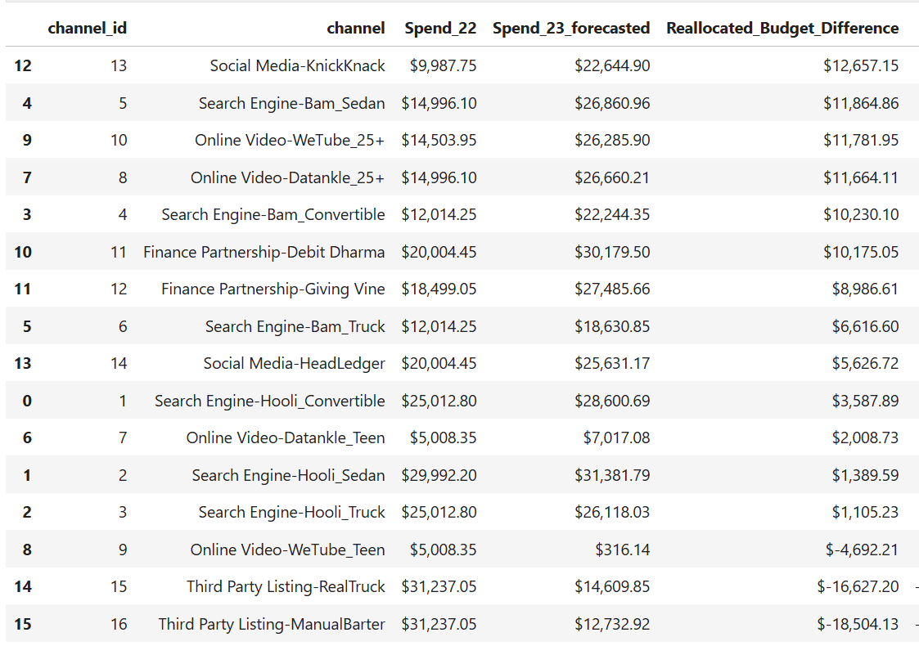

Slide 5
Based on the above table, I would recommend higher budget allocation for channels in the order.
For year 2023- Social Media KnickKnack, Search Engine(Bam Sedan), OnlineVideo_Wetube(25+), OnlineVideo(Datankle 25+). Since these channels contribute to maximum ROI and potentially higher sales.
Third Party Listing channels(Real Truck, Manual Barter) and Online Video WeTube Teen should have lower budget allocation as these channels have marginal ROI and lower weighted score.
Business Decision

Slide 6
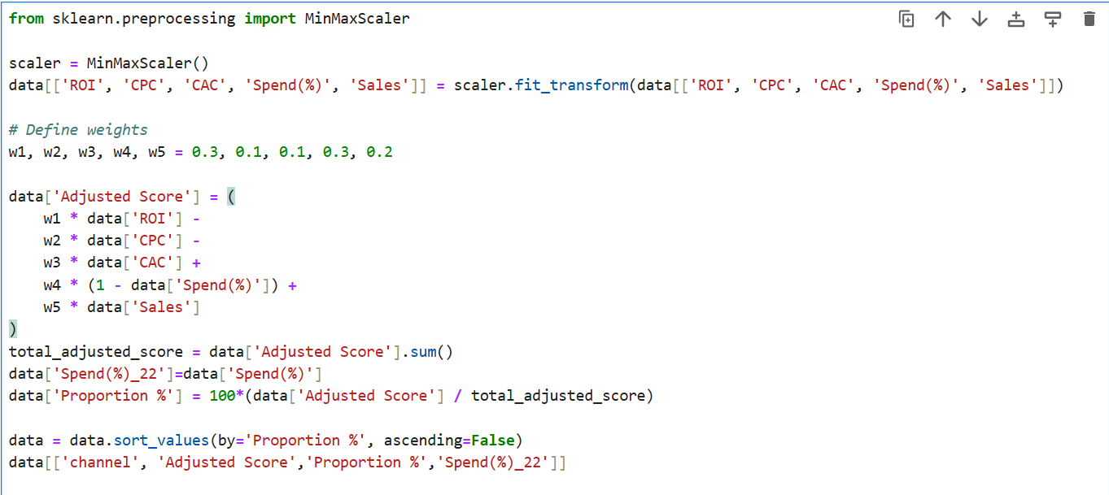
Weights (w1 to w5) are assigned based on priority level for business metrics.
As data analyst, for this business use case- I would be more particular about ROI, Spent(%) than CPC,CAC.
Hence, I would prefer higher weightage to them. However, I would like to adjust the spendings in an incremental order based on performance of these channels throughout the year.

Slide 7
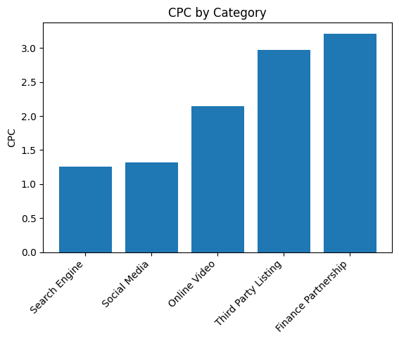
1. What Category of channel has lowest click per rate?
Segment out the category from the given ad channel.
Join Spends, ad channels and clicks table to create an aggregated view for easier calculation
Calculate the (total spend/total clicks) grouped by each category ordered by lowest CPC. We get Search Engine (1.26) as the category of channel with lowest CPC.
Problem statement

Slide 8
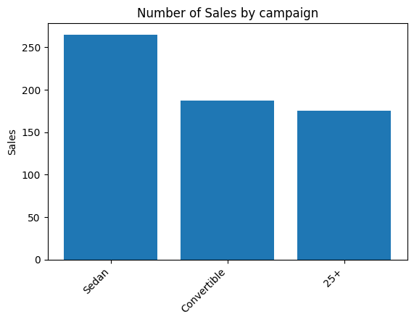
2. What are the top three campaigns in terms of number of sales generated by first touch attribution?
Filter out first click users from clicks table by adding the condition of first click timestamp of each user_id.
Join the above table with sales table.
Table on the right shows the top-3 campaigns. Sedan campaign has highest number of sales.
Problem statement

Slide 9
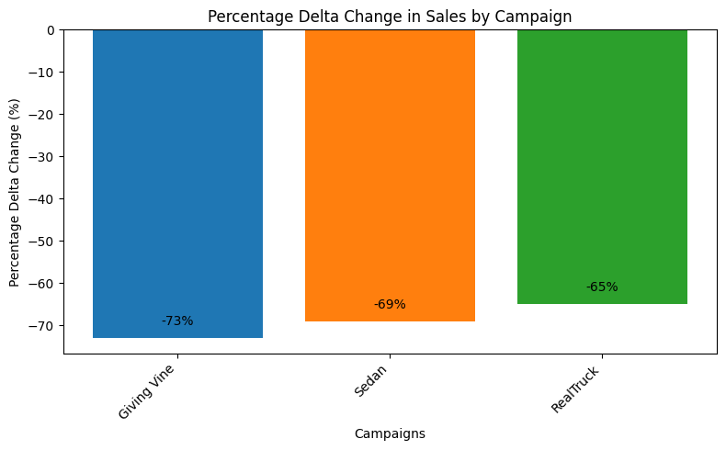
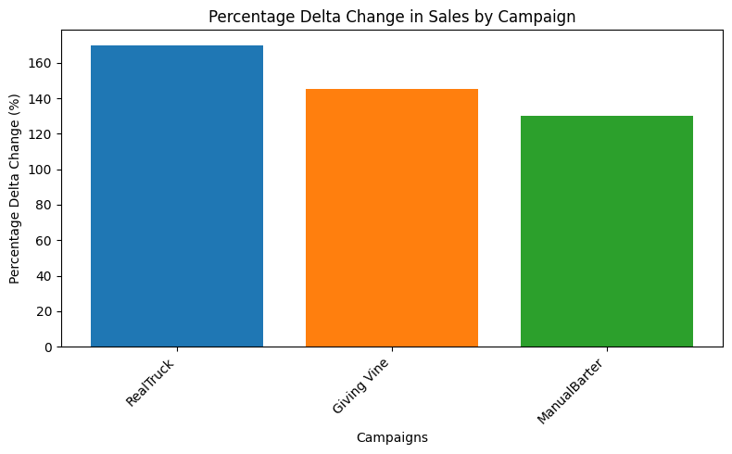
3. What are the top three campaigns in terms of number of sales generated by first touch attribution?
I followed the steps as in (Q2) .Calculated number of sales by month, campaigns and added filter for months 9,10,11,12.
Calculated lag of sales, partitioned over month to calculate month over month sales.
I observed there’s a seasonality factor in number of sales. October and December recorded higher sales but November had much less sales.
Problem statement

Slide 10
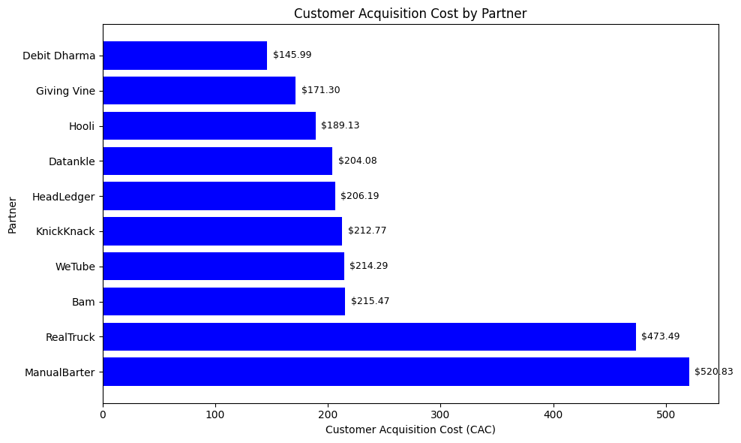
4. Which partner has lowest CAC, most efficient?
I applied first touch attribution filter to track the first click of customers.
Then I grouped the number of sales observed by partner. Filter first click users from clicks table by adding the condition of first click timestamp of customers.
Customer acquisition cost (CAC) is total ad spend/ number of
Sales. The bar graph on the right gives the estimated numbers,
Debit Dharma has lowest (CAC) $145.99
Problem statement

Slide 11
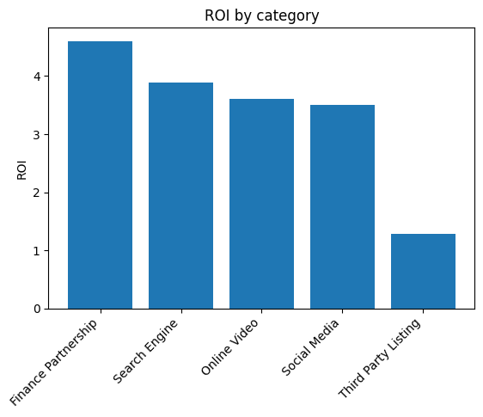
5. Which category of channel has best ROI and worst ROI?
Problem statement
For profit calculation, Annual Percentage rate (APR) is required. The APR modifier value(Conditional APR) is dynamic and it depends on the average APR of that particular month across the sales.
Create rules based on bodystyle considerations such as Sedan, Suv, Coupe etc. Profit is calculated with various variables in place such as trade, delivery distance, average ,margin.
Return on Investment (ROI) is gross profit/total ad spend. The bar graph on the right shows Finance Partnership has highest ROI (4.6), Third party listing has lowest ROI(1.29).

Slide 12
6. On average, how many different channels do customers interact with prior to locking a car? (Answer=4 unique channels)
Similar to first click users, I calculated first lock users and then grouped users by their id’s.
Join the locks temp table and clicks to get the number of unique channel ids for each user id and making sure the condition locktime>clicktime is applied to ensure integrity. Now group them by user id.
Sum the unique channel ids for each user and divide with total set of users. This gives us a result of 4.
Problem statement

Slide 13
7. What % of sales don’t have a click within 90 days prior to the conversion?
I derived last channel clicks before sale by filtering max(click datetime) and grouped users by their ids.
Sale Datetime is in different format from Click Datetimetime, hence I formatted it to assist in calculating days difference. I used a filter of > 90 days between conversion timestamp and last click prior to conversion.
Select count of rows that follow 90 days difference and divide them by total number of rows which primarily are the number of sales by non-null user ids. Finally sum the unique channel ids for each user and divide with total set of users. This gave a result of 0.14% of sales.
Problem statement

Slide 14
Thank You

